Slide 1
HTTP & REST APIs
Everybody’s doing it

Slide 2
HTTP: The least you need to know

Slide 3
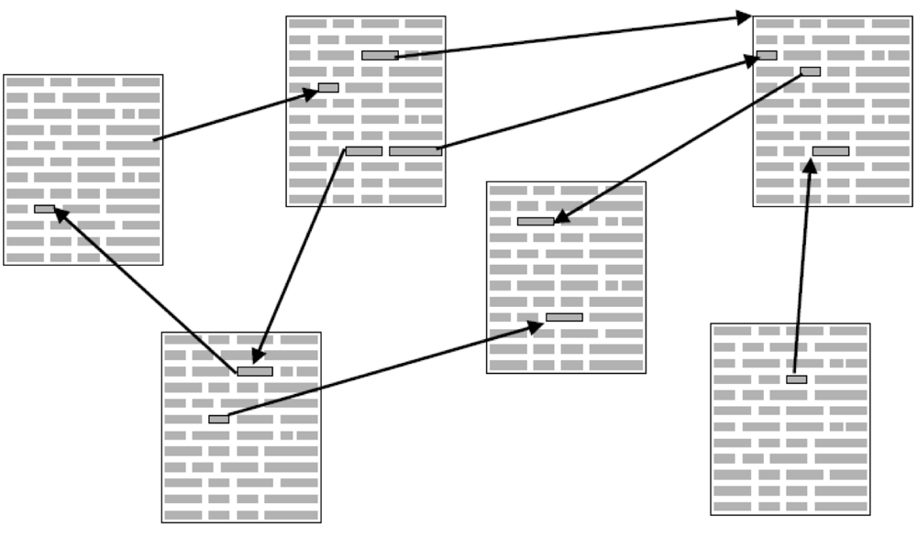
Hypertext Transfer Protocol
“The foundation of data communication for the World Wide Web.” [src]
Exchanges hypertext
We’ve been using Hypertext Markup Language (HTML)
Notes:
hypertext is structured text that uses logical links (hyperlinks) between nodes containing text

Slide 4
HTTP Client
HTTP Server
A program
Establishes a connection to the server
Sends one or more HTTP requests
A program
Accepts connections
Services HTTP requests by sending responses
Notes:
These could even be the SAME program!!!

Slide 5
Client request for primeacademy.io
method
URI
protocol version
GET / HTTP/1.1 Host: primeacademy.io Connection: keep-alive Accept: text/html,application/xhtml+xml,application/xml;q=0.9,image/webp,*/*;q=0.8
Notes:
A client sends an HTTP request to a server in the form of a request message, beginning with a request-line that includes a method, URI, and protocol version (Section 3.1.1), followed by header fields containing request modifiers, client information, and representation metadata (Section 3.2), an empty line to indicate the end of the header section, and finally a message body containing the payload body (if any, Section 3.3).

Slide 6
Server response for client request
protocol version
success/error code
textual reason phrase
HTTP/1.1 200 OK Server: Cowboy Connection: close Date: Sun, 29 Nov 2015 02:49:20 GMT Status: 200 OK X-Frame-Options: SAMEORIGIN X-Xss-Protection: 1; mode=block X-Content-Type-Options: nosniff Content-Type: text/html; charset=utf-8
Notes:
A server responds to a client's request by sending one or more HTTP response messages, each beginning with a status line that includes the protocol version, a success or error code, and textual reason phrase (Section 3.1.2), possibly followed by header fields containing server information, resource metadata, and representation metadata (Section 3.2), an empty line to indicate the end of the header section, and finally a message body containing the payload body (if any, Section 3.3).

Slide 7
HTTP (Most Used) Methods

Slide 8
Request Methods
Method | Description
GET | Transfer a current representation of a target resource.
POST | Perform resource-specific processing on the request payload.
PUT | Replace all current representations of the target resource with the request payload.
DELETE | Remove all current representations of the target resource.

Slide 9
For Example

Slide 10
Meet Rando, an HR/Talent Company
Rando has an internal system that allows them to manage talent data (e.g. consultants) and company relationships.
Their goal is to place talent at companies at a rate that suits both parties.
They have internal applications that allow them to meet their goals.
Data is transferred from the enterprise backend system to internal apps via the HTTP protocol.

Slide 11
Available HTTP Resources
Talent
TalentID
Name
Address
Skills
Salary Requirements
Employment History
Current Placement
Company
CompanyID
Name
Contact
Address
Opportunities
Account Rep

Slide 12
HTTP Requests on the Talent resource
Method | URI | Expected Response
GET | /talent | A collection of all talent
GET | /talent/34 | The talent with an ID of 34
POST | /talent | Add a new talent
PUT | /talent/34 | Update the talent with ID of 34 with our updated representation
DELETE | /talent/34 | Remove the talent with an ID of 34 from our collection of talent

Slide 13
REST API History

Slide 14

Pre-REST exchange of data w/external sys.

Slide 15
Roy Fielding introduces REST

Slide 16
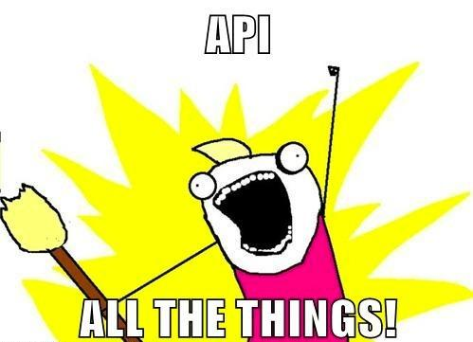
Today

Slide 17
What makes it RESTful?

Slide 18
RESTful API Characteristics
Uses HTTP protocol
Multiple endpoints represent resources
Uses HTTP methods/verbs
Hypermedia controls
Actually not present in most REST APIs today
Allows for discoverable next actions for a resource

Slide 19
Etcetera

Slide 20
Resources
W3C HTTP specifications
HTTP Header Field Definitions
HTTP Method Definitions
SOAP (a way to exchange data that became less popular post-REST)
Roy Fielding’s dissertation
Haters gonna HATEOAS -- on how most REST APIs aren’t actually RESTful

Slide 21
Love this lecture?
Daily feedback form! http://goo.gl/forms/drAE4Z9xAY

Slide 22
Hate this lecture?
Daily feedback form! http://goo.gl/forms/drAE4Z9xAY

